Slide 1
Measuring Stress During Exams
Kate Meinke
Shelbie Graham

Slide 2
Introduction
01. Data Collection
02. Featured Variables (EDA, HR, ACC)
03. Missing and Created Variables
Notes:
Data Collection: The data collection method was to measure skin conductance recordings using a wristband while taking their exams. (published in may 2022)
Featured variables: The most direct measure of sympathetic nervous system activity is EDA, heart rate was also very reactive, and ACC (movement) was also a high indicator of stress as it generally increases with stress.
Missing and Created Variables: no missing variables, but all variables were scaled differently and had a different sampling frequency so we had to adjust to merge them all on time (in seconds). We also created the composite stress score to weight the different featured variables (accounting for unrelated movement and heart rate)

Slide 3
Research Questions/Project Goals
How do stress-related biometric signals change across 3 exams? (Do students get more stressed or learn to handle it better throughout the year?)
Do students with higher physiological stress patterns tend to have lower grades?
Which measure appears to vary the most during the exams?

Slide 4
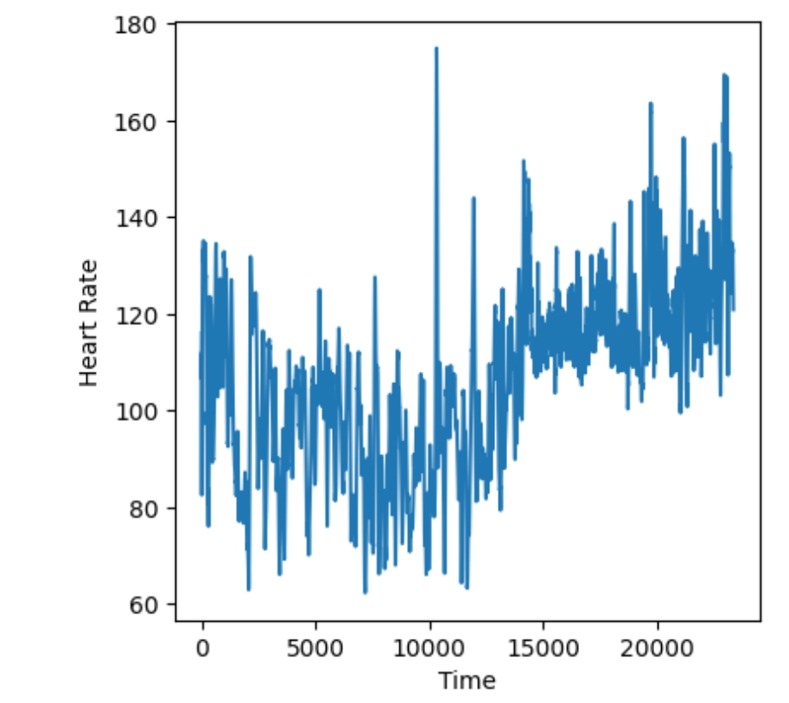
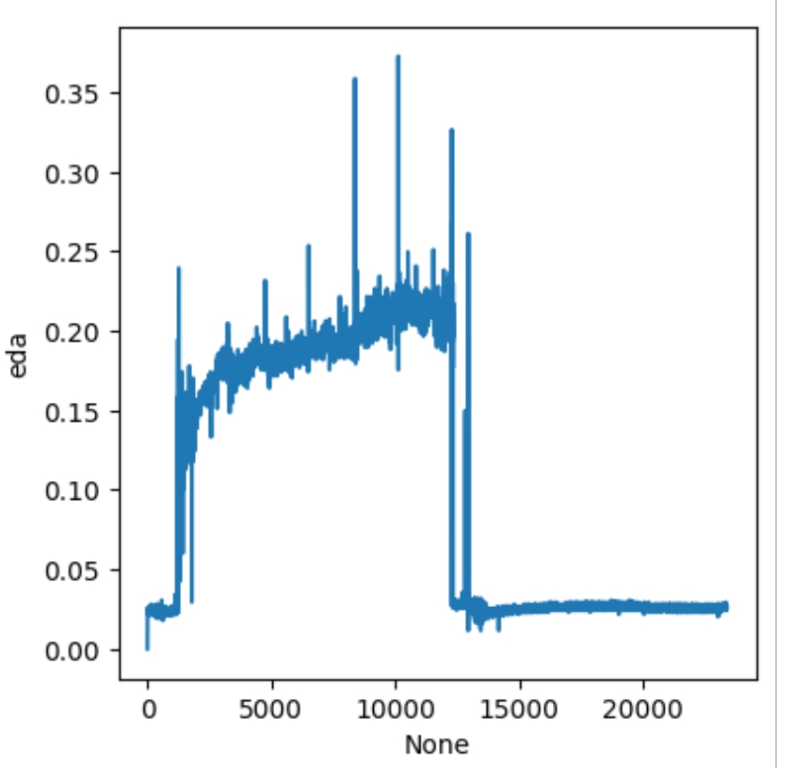
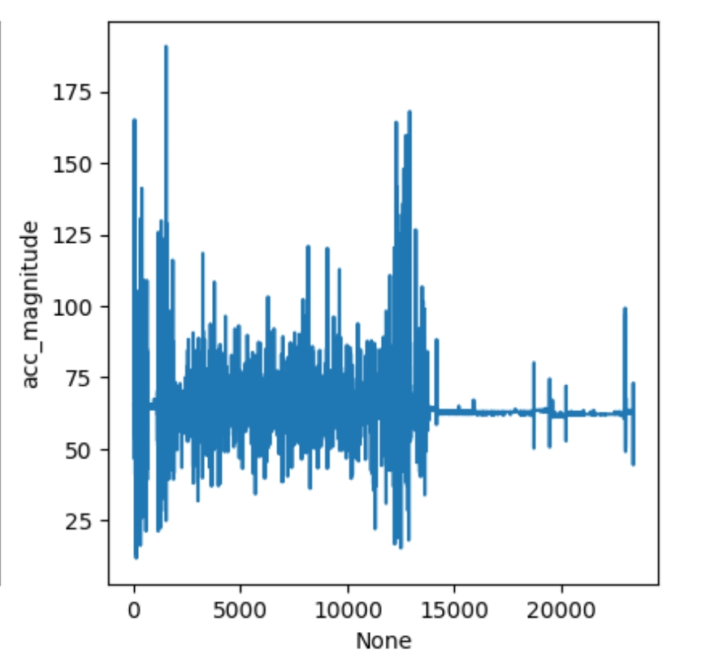
Student 1: Final
Notes:
-heart rate fluctuates heavily, directly related to ACC because of movement. -straight line at the end could be an easy part of test,

Slide 5
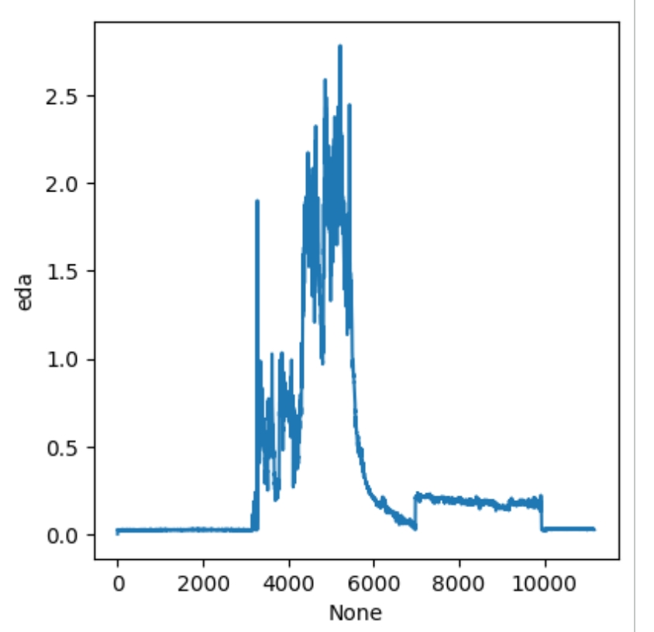
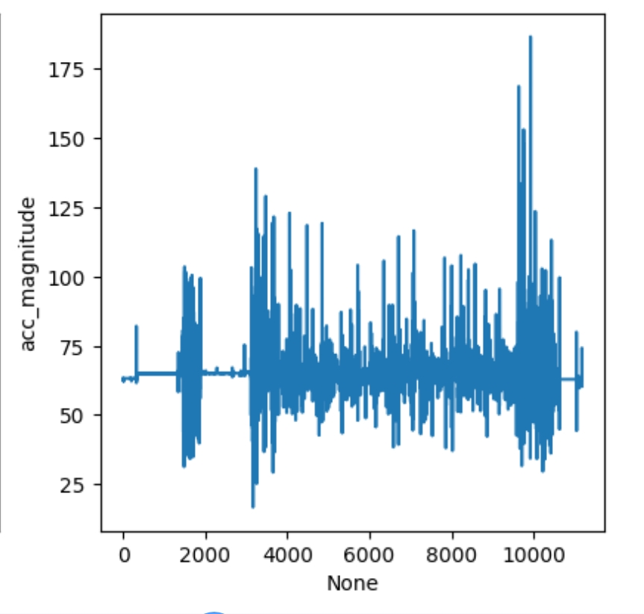
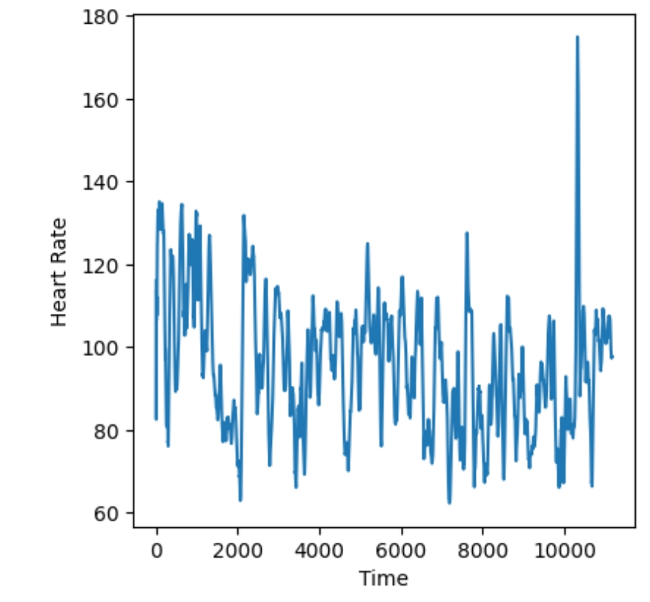
Student 1: Midterm 1
Notes:
Straight line at beginning could mean test is just now starting, then harder questions come along (big spikes).

Slide 6
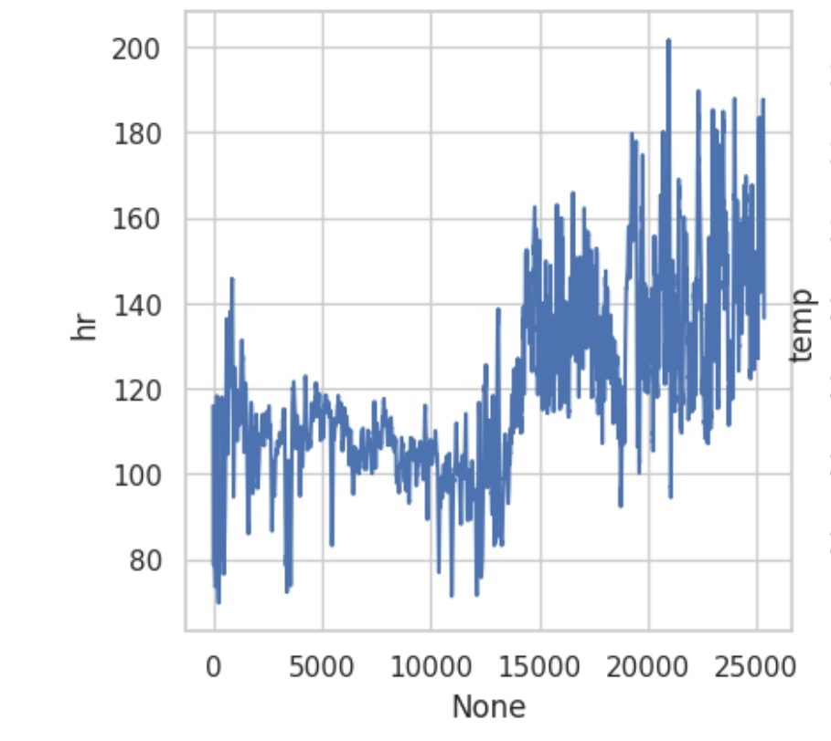
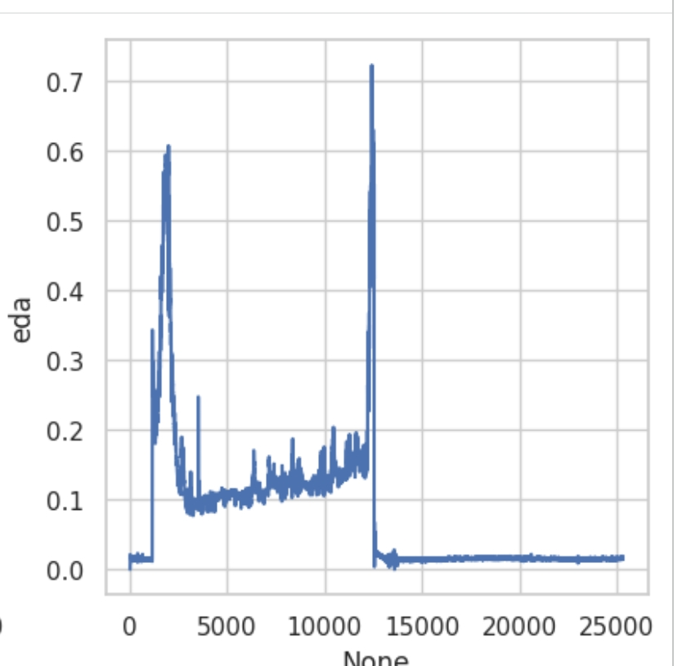
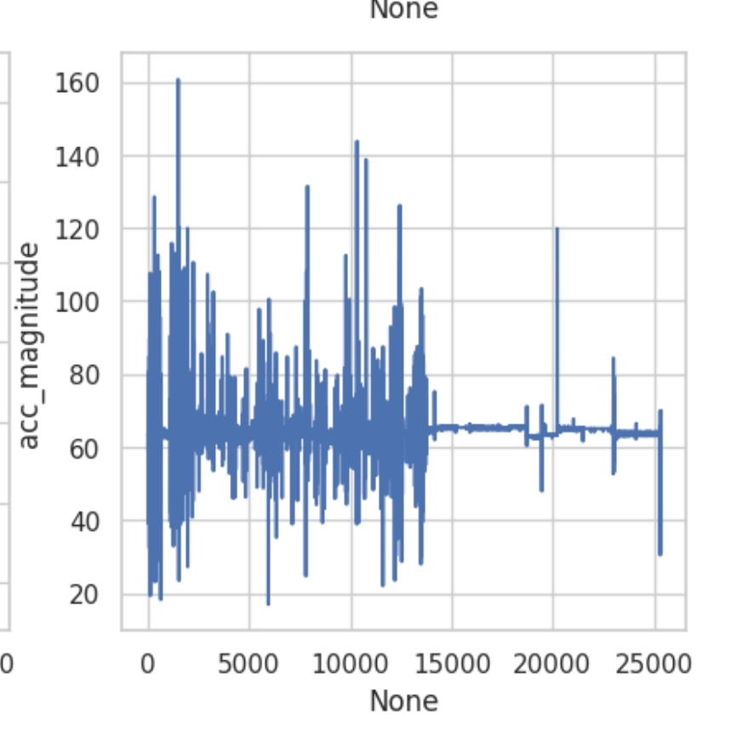
Student 2:
Final
Notes:
Final for all students have similar graphs because the test follows the same structure. High heart rate, high ACC because movement is related to HR

Slide 7
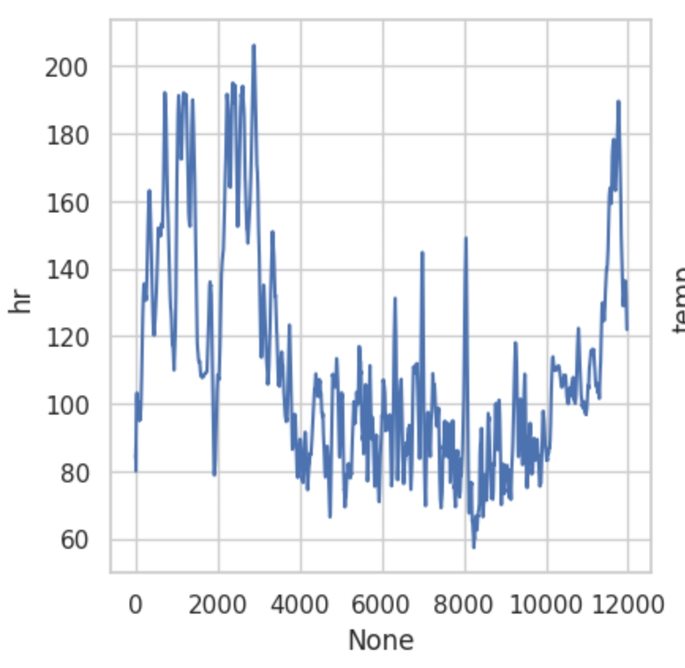
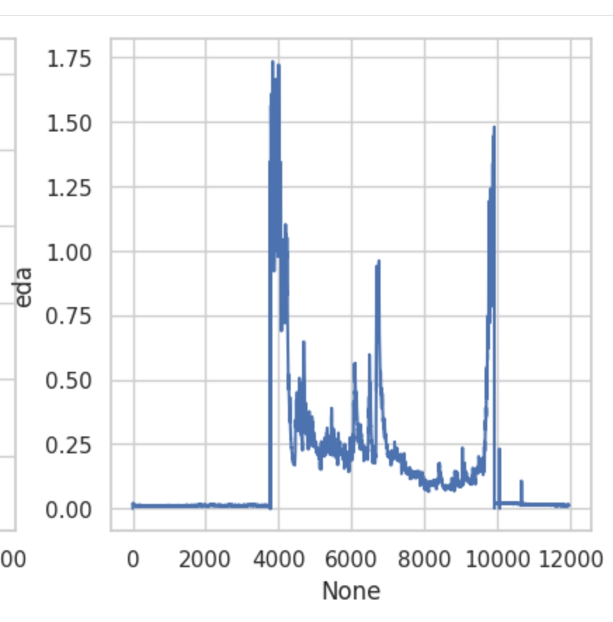
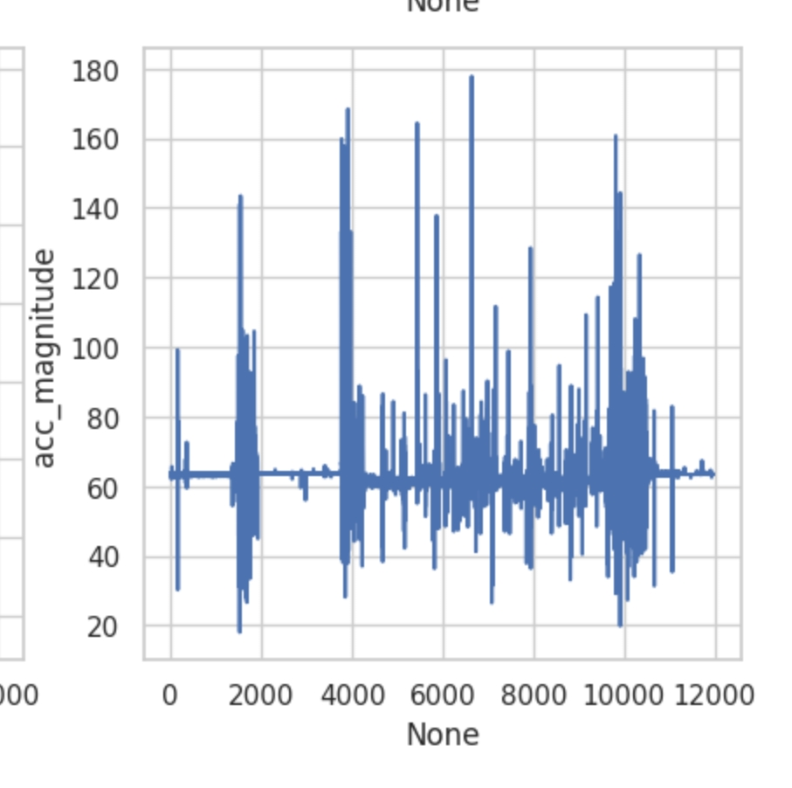
Student 2:
Midterm 1
Notes:
-graphs look like student two midterm 1 because test is similar, has high heart rate, very inconsistent ACC

Slide 8
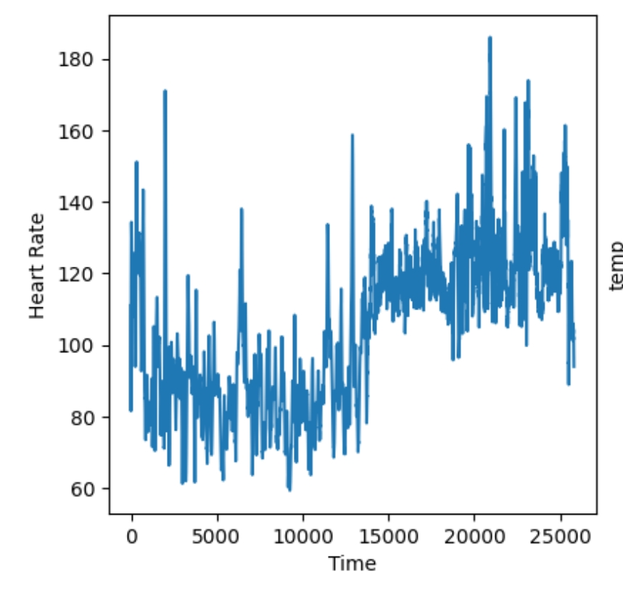
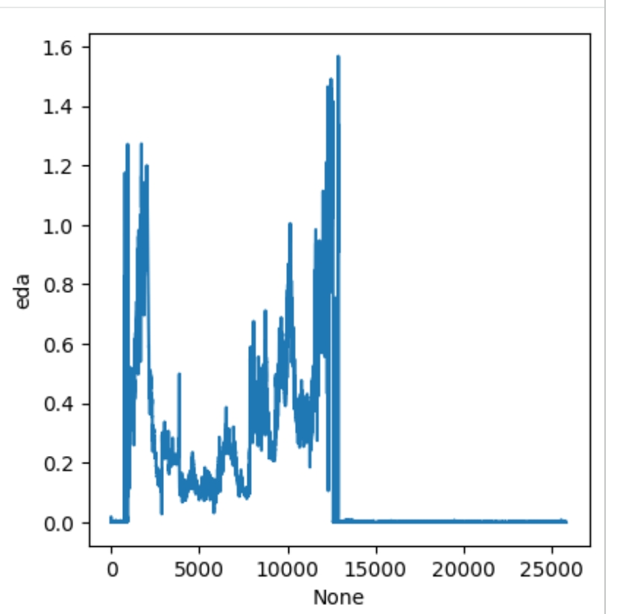
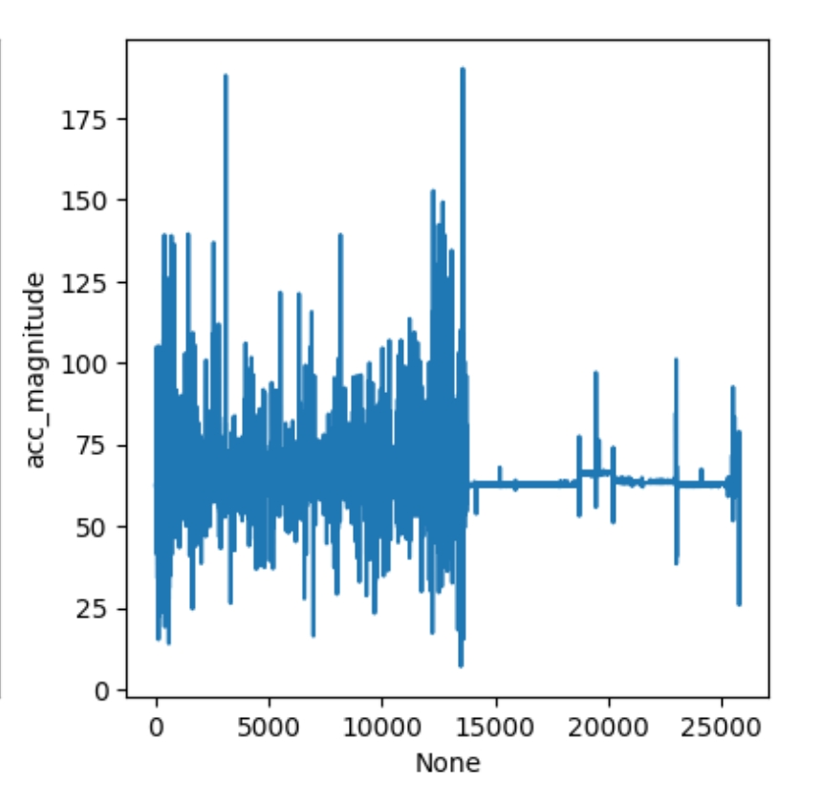
Student 3:
Final
Notes:
Looks like student 2 final graphs, with similar jumps because of similar test

Slide 9
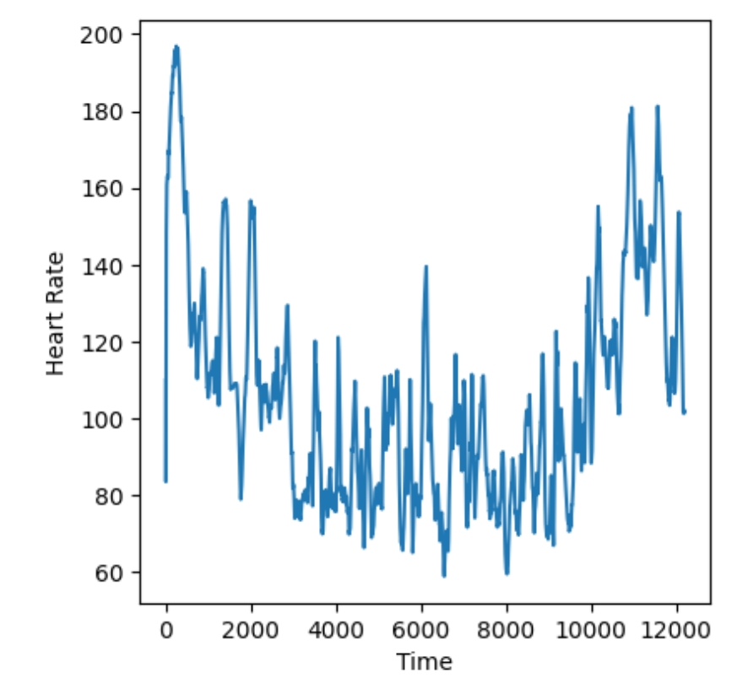
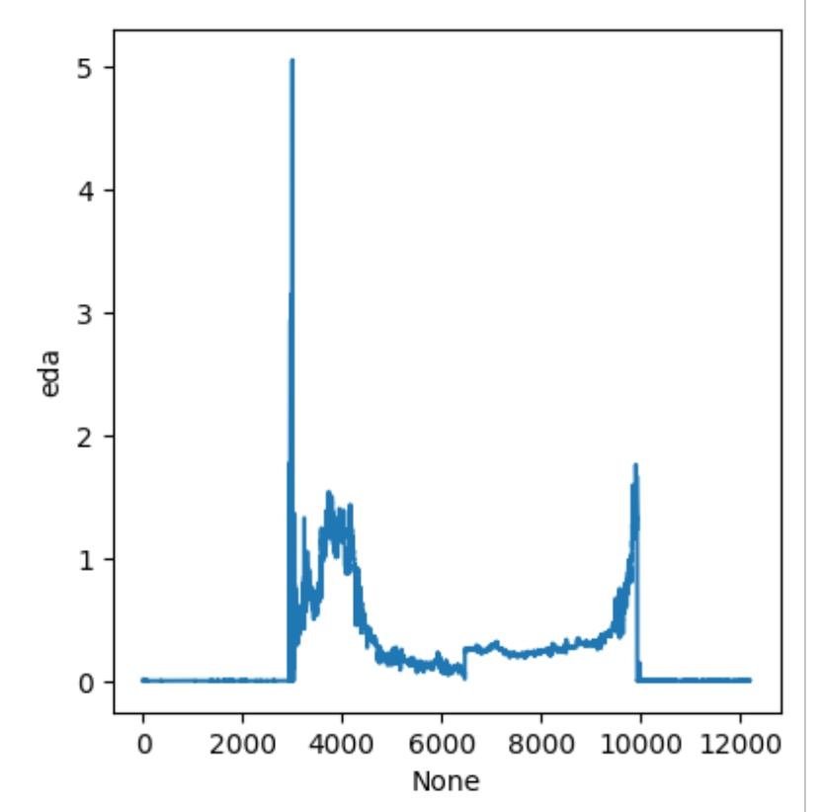
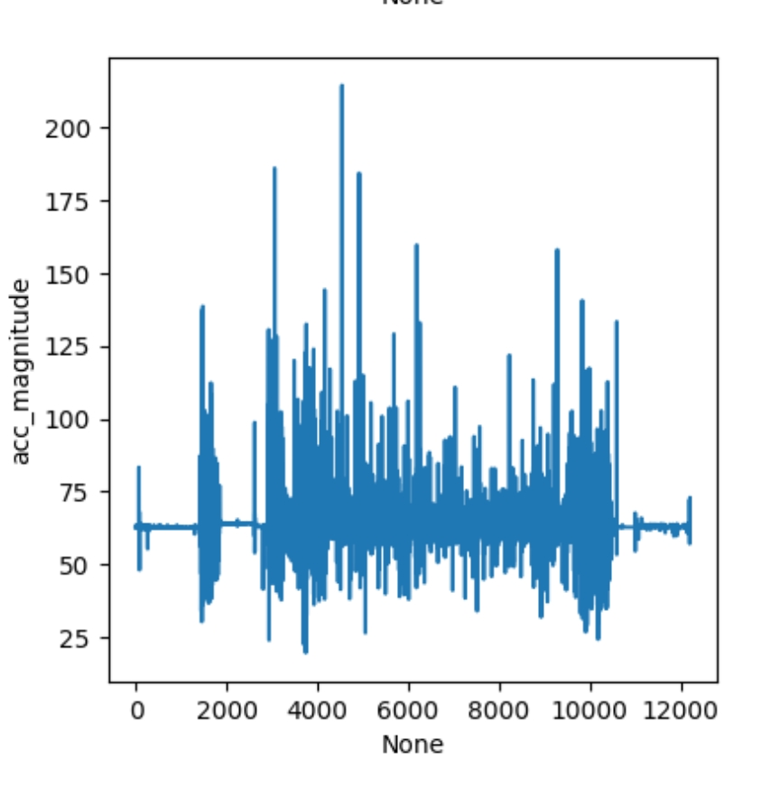
Student 3:
Midterm 1
Notes:
EDA graph has large spike possibly because of a difficult question, while the rest of the graph is somewhat calmer, with potentially somewhat difficult questions

Slide 10
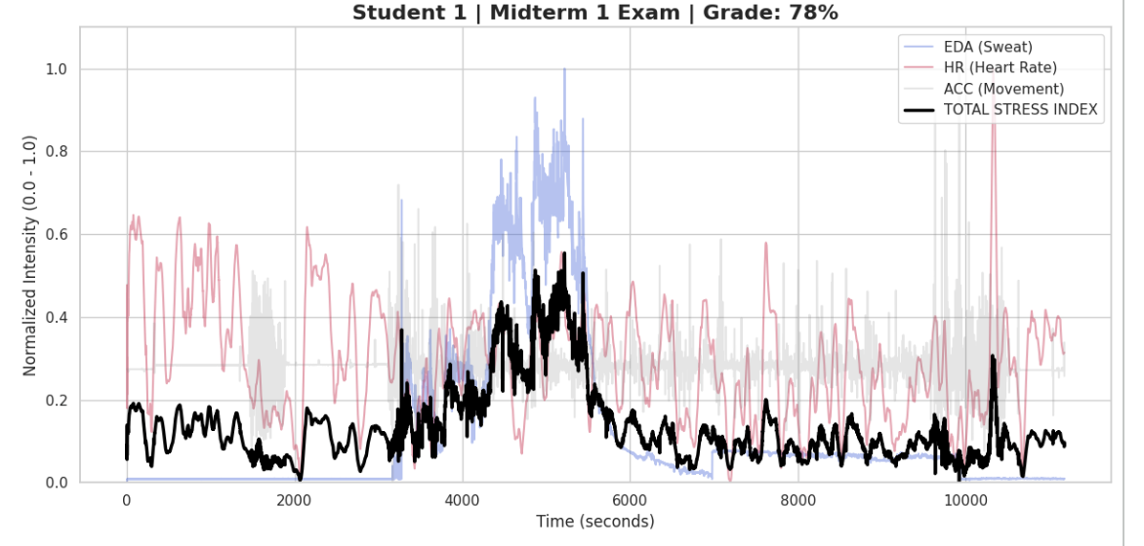
Midterm #1
High Spike/Erratic
Lowest grade
Peaks around .6
Notes:
Student 1 experiences a big spike in EDA and overall stress that reaches its peack for the exam. This state indicates high arousal, suggesting the student had intense mental effort or high stress. Additionally, the student's movement remained low during the spikes and variations, so we can assume that the stress and arousal was purely caused by mental stress rather than physical movement.They also performed the poorest on the exam.

Slide 11
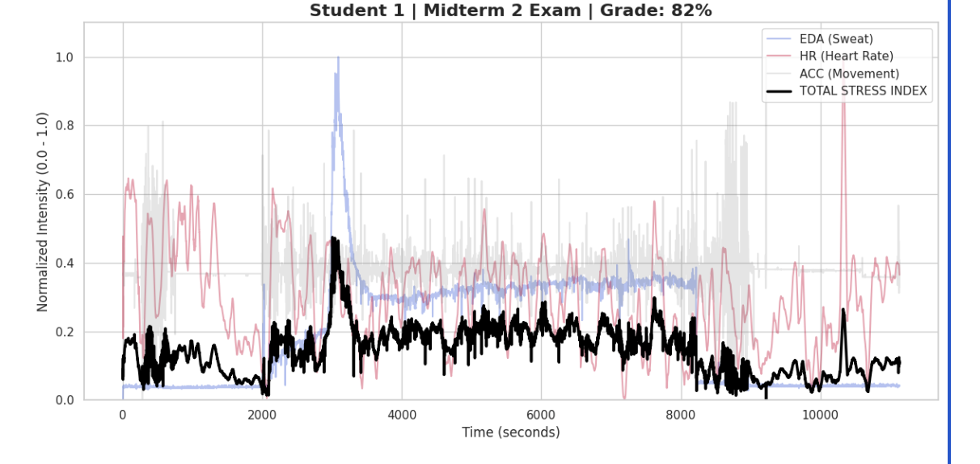
Midterm #2
Moderate Spike/more sustained
Higher Grade
Peaks around .45
Notes:
The student still experiences a sharp rise in EDA that occurs a little earlier in the exam. The way the student recovers and the overall stress volume has decreased since midterm 1. The student scored higher on this exam than the first. They sustained more rather than having sharp and sudden peaks

Slide 12
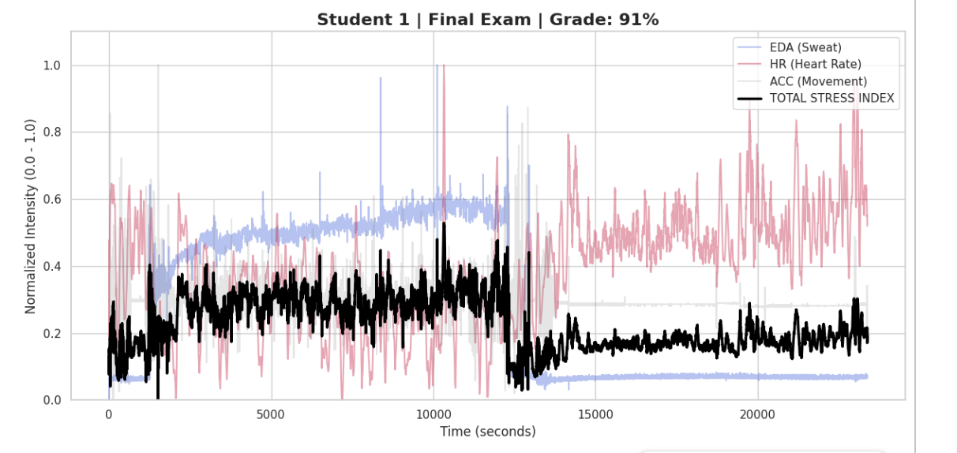
Final Exam
Controlled build/steady increase
Highest grade
Peaks around .4
Notes:
During the final Exam, student 1 is stressed but much more stable in comparison to midterms 1 and 2. The activity/arousal builds slowly and remains much more controlled than in previous exams. The peak and variation is much lower, which shows the student was much less erratic suggesting they had more focus and less emotional volatility. Student 1 recieved their highest grade on this exam.

Slide 13
Analysis: Research Goal #1
The EDA patterns became less erratic and more controlled from exam to exam
The peak stress decreased throughout the course
The “stress” was never 0, indicating eustress or mental focus and its positive impact on performance
“
Notes:
How do stress-related biometric signals change across 3 exams? (Do students get more stressed or learn to handle it better throughout the year?)

Slide 14
Analysis: Research Goal #2
“High” stress patterns don’t necessarily associate with poor exam performance
Peak stress was higher with lower exam scores, but when the student performed better, they still had some “alert” signals
“
Notes:
Do students with higher physiological stress patterns tend to have lower grades?

Slide 15
Analysis: Research Goal #3
EDA, Heart Rate, and ACC were the main variables focused on due to their higher correlation to stress signals in the body.
Heart Rate fluctuated the most during an exam.
This could be caused by the activation of the sympathetic nervous system caused by stress or intense focus
“

Slide 16
Further Steps
Mindfulness: personal physical information, consent + privacy, test score information
Next Steps: acquire more information about the course and students, use more students
“

